Slide 1
Backend Development with Java

Slide 2
What is Java?
Java is a popular programming language, created in 1995.
It is owned by Oracle, and more than 3 billion devices run Java.
It is used for:
Mobile applications (specially Android apps)
Desktop applications
Web applications
Web servers and application servers
Games
Database connection
And much, much more!

Slide 3
Features of Java
Java works on different platforms (Windows, Mac, Linux, Raspberry Pi, etc.)
It is one of the most popular programming language in the world
It has a large demand in the current job market
It is easy to learn and simple to use
It is open-source and free
It is secure, fast and powerful
It has a huge community support (tens of millions of developers)
Java is an object oriented language which gives a clear structure to programs and allows code to be reused, lowering development costs
As Java is close to C++ and C#, it makes it easy for programmers to switch to Java or vice versa

Slide 4
First Java Program | Hello World Example
// Your First Program
class HelloWorld {
public static void main(String[] args) {
System.out.println("Hello, World!");
}
}

Slide 5
Internal Details of Hello Java Program
// Your First Program
In Java, any line starting with // is a comment. Comments are intended for users reading the code to understand the intent and functionality of the program. It is completely ignored by the Java compiler (an application that translates Java program to Java bytecode that computer can execute). To learn more, visit Java comments.

Slide 6
class HelloWorld {
// Your Code
}
In Java, every application begins with a class definition. In the program, HelloWorld is the name of the class, and the class definition is:
For now, just remember that every Java application has a class definition, and the name of the class should match the filename in Java.

Slide 7
public static void main(String[] args) {
// Statements
}
This is the main method. Every application in Java must contain the main method. The Java compiler starts executing the code from the main method.
How does it work? Good question. However, we will not discuss it in this article. After all, it's a basic program to introduce Java programming language to a newbie. We will learn the meaning of public, static, void, and how methods work? in later chapters.
For now, just remember that the main function is the entry point of your Java application, and it's mandatory in a Java program. The signature of the main method in Java is:

Slide 8
System.out.println("Hello, World!");
The code above is a print statement. It prints the text Hello, World! to standard output (your screen). The text inside the quotation marks is called String in Java.
Notice the print statement is inside the main function, which is inside the class definition.

Slide 9
Things to take away
Every valid Java Application must have a class definition that matches the filename (class name and file name should be same).
The main method must be inside the class definition.
The compiler executes the codes starting from the main function.

Slide 10
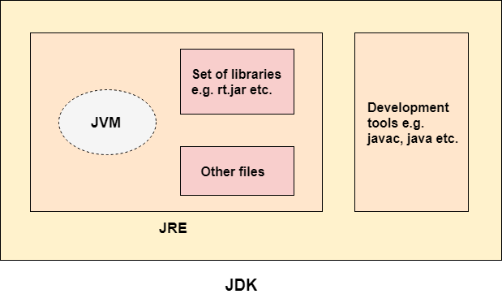
Difference between JDK, JRE, and JVM

Slide 11
Data Types & Variables
Variables are containers for storing data values.
Data types are divided into two groups:
Primitive data types - includes byte, short, int, long, float, double, boolean and char
Non-primitive data types - such as String, Arrays and Classes

Slide 12
Primitive Data Types
A primitive data type specifies the size and type of variable values, and it has no additional methods.
There are eight primitive data types in Java:

Slide 13
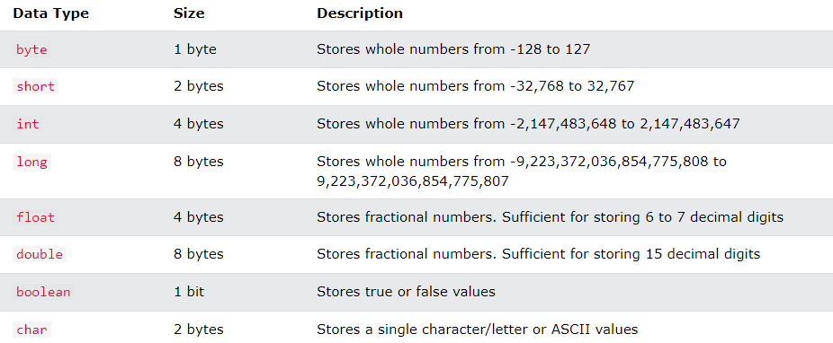

Slide 14
Non-Primitive Data Types
The main difference between primitive and non-primitive data types are:
Primitive types are predefined (already defined) in Java. Non-primitive types are created by the programmer and is not defined by Java (except for String).
Non-primitive types can be used to call methods to perform certain operations, while primitive types cannot.
A primitive type has always a value, while non-primitive types can be null.
A primitive type starts with a lowercase letter, while non-primitive types starts with an uppercase letter.
The size of a primitive type depends on the data type, while non-primitive types have all the same size.
Examples of non-primitive types are Strings, Arrays, Classes, Interface, etc. You will learn more about these in a later chapter.

Slide 15
Operators & Keywords
Operators are used to perform operations on variables and values.
Java divides the operators into the following groups:
Arithmetic operators
Assignment operators
Comparison operators
Logical operators
Bitwise operators

Slide 16
If-else Statement
You already know that Java supports the usual logical conditions from mathematics:
Less than: a < b
Less than or equal to: a <= b
Greater than: a > b
Greater than or equal to: a >= b
Equal to a == b
Not Equal to: a != b

Slide 17
if (20 > 18) {
System.out.println("20 is greater than 18");
}
-------------------------------------------------------------------
int time = 20;
if (time < 18) {
System.out.println("Good day.");
} else {
System.out.println("Good evening.");
}

Slide 18
Short Hand If...Else
int time = 20;
String result = (time < 18) ? "Good day." : "Good evening.";
System.out.println(result);

Slide 19
Switch Statement
int day = 4;
switch (day) {
case 6:
System.out.println("Today is Saturday");
break;
case 7:
System.out.println("Today is Sunday");
break;
default:
System.out.println("Looking forward to the Weekend");
}

Slide 20
For , While & Do While Loops
While loop:
int i = 0;
while (i < 5) {
System.out.println(i);
i++;
}

Slide 21
Do/While Loop
int i = 0;
do {
System.out.println(i);
i++;
}
while (i < 5);

Slide 22
For Loop:
for (int i = 0; i < 5; i++) {
System.out.println(i);
}

Slide 23
Classes & Objects
Java is an object-oriented programming language.
Everything in Java is associated with classes and objects, along with its attributes and methods. For example: in real life, a car is an object. The car has attributes, such as weight and color, and methods, such as drive and brake.
A Class is like an object constructor, or a "blueprint" for creating objects.

Slide 24
Create a Class
class Main {
}

Slide 25
Create an Object
Main myObj = new Main();

Slide 26
Methods
A method is a block of code which only runs when it is called.
You can pass data, known as parameters, into a method.
Methods are used to perform certain actions, and they are also known as functions.
Why use methods? To reuse code: define the code once, and use it many times.

Slide 27
Create a Method
public class Main {
void myMethod() {
// code to be executed
}
}

Slide 28
Call a Method
myMethod();

Slide 29
Parameters and Arguments
Information can be passed to methods as parameter. Parameters act as variables inside the method.
Parameters are specified after the method name, inside the parentheses. You can add as many parameters as you want, just separate them with a comma.

Slide 30
Java Class Attributes
Accessing Attributes
Modify Attributes

Slide 31
Java Constructors
A constructor in Java is a special method that is used to initialize objects. The constructor is called when an object of a class is created. It can be used to set initial values for object attributes:

Slide 32
Static , This & Final Keywords
The static keyword means the value is the same for every instance of the class. The final keyword means once the variable is assigned a value it can never be changed.
The this keyword can be used to refer current class instance variable. If there is ambiguity between the instance variables and parameters

Slide 33
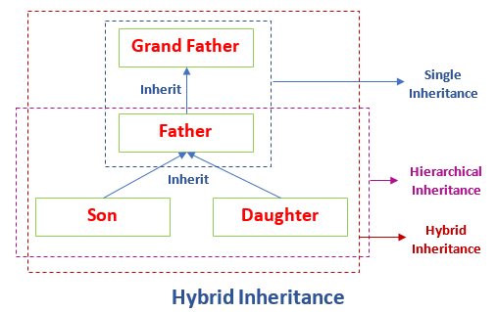
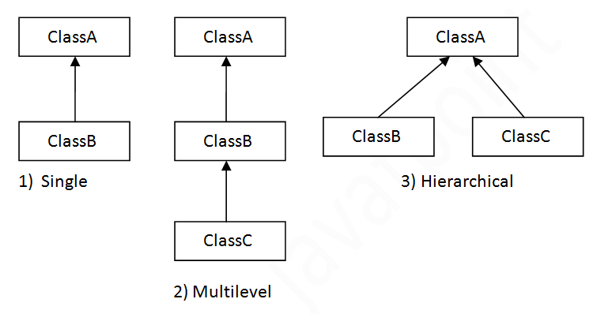
Inheritance

Slide 34
Polymorphism
Polymorphism means "many forms", and it occurs when we have many classes that are related to each other by inheritance.

Slide 35
Method Overriding
If subclass (child class) has the same method as declared in the parent class, it is known as method overriding in Java.

Slide 36
If a class has multiple methods having same name but different in parameters, it is known as Method Overloading

Slide 37
Abstraction & Encapsulation
Encapsulation is defined as the wrapping up of data under a single unit. It is the mechanism that binds together code and the data it manipulates. Another way to think about encapsulation is, that it is a protective shield that prevents the data from being accessed by the code outside this shield. Technically in encapsulation, the variables or data of a class is hidden from any other class and can be accessed only through any member function of its own class in which they are declared. As in encapsulation, the data in a class is hidden from other classes, so it is also known as data-hiding. Encapsulation can be achieved by Declaring all the variables in the class as private and writing public methods in the class to set and get the values of variables.

Slide 38
Data abstraction is the process of hiding certain details and showing only essential information to the user.
Abstraction can be achieved with either abstract classes or interfaces
Abstract class: is a restricted class that cannot be used to create objects (to access it, it must be inherited from another class).

Slide 39
Interfaces
Another way to achieve abstraction in Java, is with interfaces.
An interface is a completely "abstract class" that is used to group related methods with empty bodies:

Slide 40
Like abstract classes, interfaces cannot be used to create objects (in the example above, it is not possible to create an "Animal" object in the MyMainClass)
Interface methods do not have a body - the body is provided by the "implement" class
On implementation of an interface, you must override all of its methods
Interface methods are by default abstract and public
Interface attributes are by default public, static and final
An interface cannot contain a constructor (as it cannot be used to create objects)

Slide 41
Why And When To Use Interfaces?
1) To achieve security - hide certain details and only show the important details of an object (interface).
2) Java does not support "multiple inheritance" (a class can only inherit from one superclass). However, it can be achieved with interfaces, because the class can implement multiple interfaces. Note: To implement multiple interfaces, separate them with a comma (see example below).

Slide 42
Thank you

